Slide 1
The analog to division in a modular world is the multiplicative inverse
INSERT
VIDEO
HERE

Slide 2
The analog to division in a modular world is the multiplicative inverse
What a multiplicative inverse is
INSERT
VIDEO
HERE

Slide 3
The analog to division in a modular world is the multiplicative inverse
What a multiplicative inverse is
When a multiplicative inverse exists
INSERT
VIDEO
HERE

Slide 4
The analog to division in a modular world is the multiplicative inverse
What a multiplicative inverse is
When a multiplicative inverse exists
The Euclidean algorithm finds the gcd
INSERT
VIDEO
HERE

Slide 5
The analog to division in a modular world is the multiplicative inverse
What a multiplicative inverse is
When a multiplicative inverse exists
The Euclidean algorithm finds the gcd
How efficient the Euclidean algorithm is
INSERT
VIDEO
HERE

Slide 6
The analog to division in a modular world is the multiplicative inverse
What a multiplicative inverse is
When a multiplicative inverse exists
The Euclidean algorithm finds the gcd
How efficient the Euclidean algorithm is
Prove the validity of the Euclidean algorithm
INSERT
VIDEO
HERE

Slide 7
The analog to division in a modular world is the multiplicative inverse
What a multiplicative inverse is
When a multiplicative inverse exists
The Euclidean algorithm finds the gcd
How efficient the Euclidean algorithm is
Prove the validity of the Euclidean algorithm
Future work – extend the Euclidean algorithm
INSERT
VIDEO
HERE

Slide 8
Division isn't defined, but multiplicative inverses are
INSERT
VIDEO
HERE

Slide 9
Division isn't defined, but multiplicative inverses are
Dividing by x = multiplying by reciprocal of x
INSERT
VIDEO
HERE

Slide 10
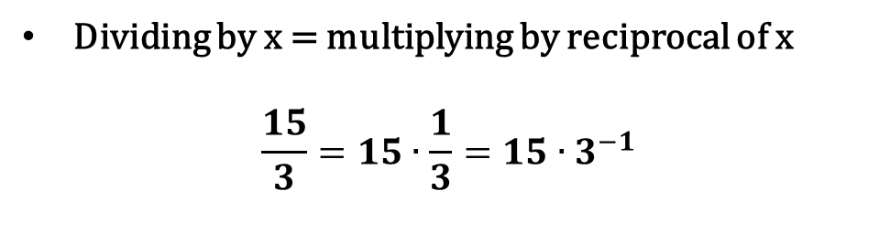
Division isn't defined, but multiplicative inverses are
Dividing by x = multiplying by reciprocal of x
$$\frac{15}{3}=15∙\frac{1}{3}=15∙3^{−1}$$
INSERT
VIDEO
HERE

Slide 11
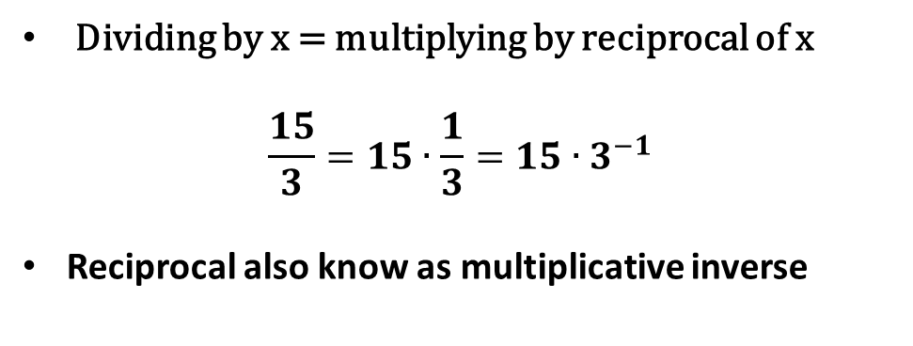
Division isn't defined, but multiplicative inverses are
Dividing by x = multiplying by reciprocal of x
$$\frac{15}{3}=15∙\frac{1}{3}=15∙3^{−1}$$
Reciprocal also know as multiplicative inverse
INSERT
VIDEO
HERE

Slide 12
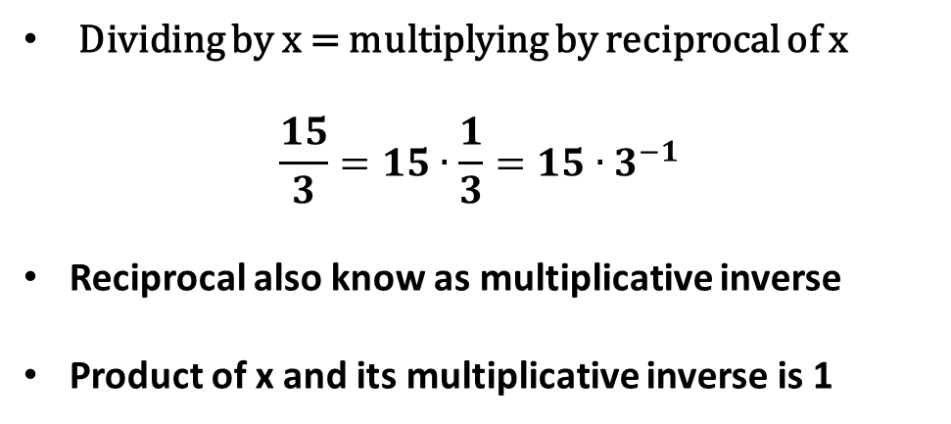
Division isn't defined, but multiplicative inverses are
Dividing by x = multiplying by reciprocal of x
$$\frac{15}{3}=15∙\frac{1}{3}=15∙3^{−1}$$
Reciprocal also know as multiplicative inverse
Product of x and its multiplicative inverse is 1
INSERT
VIDEO
HERE

Slide 13
mod-7 multiplication table shows every nonzero residue class has an inverse
INSERT
VIDEO
HERE

Slide 14
mod-7 multiplication table shows every nonzero residue class has an inverse
mod 7 | 0 | 1 | 2 | 3 | 4 | 5 | 6
0 | 0 | 0 | 0 | 0 | 0 | 0 | 0
1 | 0 | 1 | 2 | 3 | 4 | 5 | 6
2 | 0 | 2 | 4 | 6 | 1 | 3 | 5
3 | 0 | 3 | 6 | 2 | 5 | 1 | 4
4 | 0 | 4 | 1 | 5 | 2 | 6 | 3
5 | 0 | 5 | 3 | 1 | 6 | 4 | 2
6 | 0 | 6 | 5 | 4 | 3 | 2 | 1
INSERT
VIDEO
HERE

Slide 15
mod-7 multiplication table shows every nonzero residue class has an inverse
mod 7 | 0 | 1 | 2 | 3 | 4 | 5 | 6
0 | 0 | 0 | 0 | 0 | 0 | 0 | 0
1 | 0 | 1 | 2 | 3 | 4 | 5 | 6
2 | 0 | 2 | 4 | 6 | 1 | 3 | 5
3 | 0 | 3 | 6 | 2 | 5 | 1 | 4
4 | 0 | 4 | 1 | 5 | 2 | 6 | 3
5 | 0 | 5 | 3 | 1 | 6 | 4 | 2
6 | 0 | 6 | 5 | 4 | 3 | 2 | 1
mod 7 | 0 | 1 | 2 | 3 | 4 | 5 | 6
0 | 0 | 0 | 0 | 0 | 0 | 0 | 0
1 | 0 | 1 | 2 | 3 | 4 | 5 | 6
2 | 0 | 2 | 4 | 6 | 1 | 3 | 5
3 | 0 | 3 | 6 | 2 | 5 | 1 | 4
4 | 0 | 4 | 1 | 5 | 2 | 6 | 3
5 | 0 | 5 | 3 | 1 | 6 | 4 | 2
6 | 0 | 6 | 5 | 4 | 3 | 2 | 1
INSERT
VIDEO
HERE

Slide 16
mod-15 multiplication table shows many nonzero residue classes don’t
Mod 15 | 0 | 1 | 2 | 3 | 4 | 5 | 6 | 7 | 8 | 9 | 10 | 11 | 12 | 13 | 14
0 | 0 | 0 | 0 | 0 | 0 | 0 | 0 | 0 | 0 | 0 | 0 | 0 | 0 | 0 | 0
1 | 0 | 1 | 2 | 3 | 4 | 5 | 6 | 7 | 8 | 9 | 10 | 11 | 12 | 13 | 14
2 | 0 | 2 | 4 | 6 | 8 | 10 | 12 | 14 | 1 | 3 | 5 | 7 | 9 | 11 | 13
3 | 0 | 3 | 6 | 9 | 12 | 0 | 3 | 6 | 9 | 12 | 0 | 3 | 6 | 9 | 12
4 | 0 | 4 | 8 | 12 | 1 | 5 | 9 | 13 | 2 | 6 | 10 | 14 | 3 | 7 | 11
5 | 0 | 5 | 10 | 0 | 5 | 10 | 0 | 5 | 10 | 0 | 5 | 10 | 0 | 5 | 10
6 | 0 | 6 | 12 | 3 | 9 | 0 | 6 | 12 | 3 | 9 | 0 | 6 | 12 | 3 | 9
7 | 0 | 7 | 14 | 6 | 13 | 5 | 12 | 4 | 11 | 3 | 10 | 2 | 9 | 1 | 8
8 | 0 | 8 | 1 | 9 | 2 | 10 | 3 | 11 | 4 | 12 | 5 | 13 | 6 | 14 | 7
9 | 0 | 9 | 3 | 12 | 6 | 0 | 9 | 3 | 12 | 6 | 0 | 9 | 3 | 12 | 6
10 | 0 | 10 | 5 | 0 | 10 | 5 | 0 | 10 | 5 | 0 | 10 | 5 | 0 | 10 | 5
11 | 0 | 11 | 7 | 3 | 14 | 10 | 6 | 2 | 13 | 9 | 5 | 1 | 12 | 8 | 4
12 | 0 | 12 | 9 | 6 | 3 | 0 | 12 | 9 | 6 | 3 | 0 | 12 | 9 | 6 | 3
13 | 0 | 13 | 11 | 9 | 7 | 5 | 3 | 1 | 14 | 12 | 10 | 8 | 6 | 4 | 2
14 | 0 | 14 | 13 | 12 | 11 | 10 | 9 | 8 | 7 | 6 | 5 | 4 | 3 | 2 | 1
INSERT
VIDEO
HERE

Slide 17
Being relatively prime to the modulus is sufficient to have a multiplicative inverse
INSERT
VIDEO
HERE

Slide 18
Being relatively prime to the modulus is sufficient to have a multiplicative inverse
gcd(a,m) = 1 (i.e., relatively prime)
INSERT
VIDEO
HERE

Slide 19
Being relatively prime to the modulus is sufficient to have a multiplicative inverse
gcd(a,m) = 1 (i.e., relatively prime)
Sequence of m values: {0·a, 1·a, 2·a, …, (m-1)·a}
INSERT
VIDEO
HERE

Slide 20
Being relatively prime to the modulus is sufficient to have a multiplicative inverse
gcd(a,m) = 1 (i.e., relatively prime)
Sequence of m values: {0·a, 1·a, 2·a, …, (m-1)·a}
Pick x and y that are NOT congruent (mod m)
INSERT
VIDEO
HERE

Slide 21
Being relatively prime to the modulus is sufficient to have a multiplicative inverse
gcd(a,m) = 1 (i.e., relatively prime)
Sequence of m values: {0·a, 1·a, 2·a, …, (m-1)·a}
Pick x and y that are NOT congruent (mod m)
Can x·a ≡ y·a (mod m) ?
INSERT
VIDEO
HERE

Slide 22
Being relatively prime to the modulus is sufficient to have a multiplicative inverse
gcd(a,m) = 1 (i.e., relatively prime)
Sequence of m values: {0·a, 1·a, 2·a, …, (m-1)·a}
Pick x and y that are NOT congruent (mod m)
Can x·a ≡ y·a (mod m) ?
Requires (x-y)·a = km
INSERT
VIDEO
HERE

Slide 23
Being relatively prime to the modulus is sufficient to have a multiplicative inverse
gcd(a,m) = 1 (i.e., relatively prime)
Sequence of m values: {0·a, 1·a, 2·a, …, (m-1)·a}
Pick x and y that are NOT congruent (mod m)
Can x·a ≡ y·a (mod m) ?
Requires (x-y)·a = km
Since ‘a’ has no factors of ‘m’, (x-y) | m
INSERT
VIDEO
HERE

Slide 24
Being relatively prime to the modulus is sufficient to have a multiplicative inverse
gcd(a,m) = 1 (i.e., relatively prime)
Sequence of m values: {0·a, 1·a, 2·a, …, (m-1)·a}
Pick x and y that are NOT congruent (mod m)
Can x·a ≡ y·a (mod m) ?
Requires (x-y)·a = km
Since ‘a’ has no factors of ‘m’, (x-y) | m
But –m < (x-y) < m and (x-y) ≠ 0
INSERT
VIDEO
HERE

Slide 25
Being relatively prime to the modulus is sufficient to have a multiplicative inverse
gcd(a,m) = 1 (i.e., relatively prime)
Sequence of m values: {0·a, 1·a, 2·a, …, (m-1)·a}
Pick x and y that are NOT congruent (mod m)
Can x·a ≡ y·a (mod m) ?
Requires (x-y)·a = km
Since ‘a’ has no factors of ‘m’, (x-y) | m
But –m < (x-y) < m and (x-y) ≠ 0
No two members of sequence are congruent
INSERT
VIDEO
HERE

Slide 26
Being relatively prime to the modulus is sufficient to have a multiplicative inverse
gcd(a,m) = 1 (i.e., relatively prime)
Sequence of m values: {0·a, 1·a, 2·a, …, (m-1)·a}
Pick x and y that are NOT congruent (mod m)
Can x·a ≡ y·a (mod m) ?
Requires (x-y)·a = km
Since ‘a’ has no factors of ‘m’, (x-y) | m
But –m < (x-y) < m and (x-y) ≠ 0
No two members of sequence are congruent
Pigeonhole Principle: 1 member is congruent to 1
INSERT
VIDEO
HERE

Slide 27
Being relatively prime to the modulus is necessary to have a multiplicative inverse
INSERT
VIDEO
HERE

Slide 28
Being relatively prime to the modulus is necessary to have a multiplicative inverse
gcd(a,m) = c > 1 (i.e., NOT relatively prime)
INSERT
VIDEO
HERE

Slide 29
Being relatively prime to the modulus is necessary to have a multiplicative inverse
gcd(a,m) = c > 1 (i.e., NOT relatively prime)
a = b·c, m = n·c where gcd(b,n) = 1
INSERT
VIDEO
HERE

Slide 30
Being relatively prime to the modulus is necessary to have a multiplicative inverse
gcd(a,m) = c > 1 (i.e., NOT relatively prime)
a = b·c, m = n·c where gcd(b,n) = 1
(x-y)a = km → (x-y)bc = knc → (x-y)b = kn
INSERT
VIDEO
HERE

Slide 31
Being relatively prime to the modulus is necessary to have a multiplicative inverse
gcd(a,m) = c > 1 (i.e., NOT relatively prime)
a = b·c, m = n·c where gcd(b,n) = 1
(x-y)a = km → (x-y)bc = knc → (x-y)b = kn
x·b produces all n residues:
INSERT
VIDEO
HERE

Slide 32
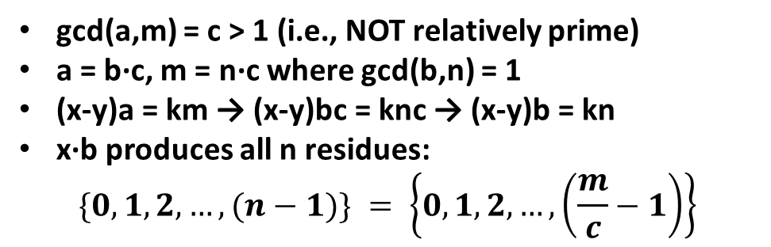
Being relatively prime to the modulus is necessary to have a multiplicative inverse
gcd(a,m) = c > 1 (i.e., NOT relatively prime)
a = b·c, m = n·c where gcd(b,n) = 1
(x-y)a = km → (x-y)bc = knc → (x-y)b = kn
x·b produces all n residues:
$$\{0,1,2,…, (n−1)\} = \left\{0,1,2,…, \left(\frac{m}{c}−1\right)\right\}$$
INSERT
VIDEO
HERE

Slide 33
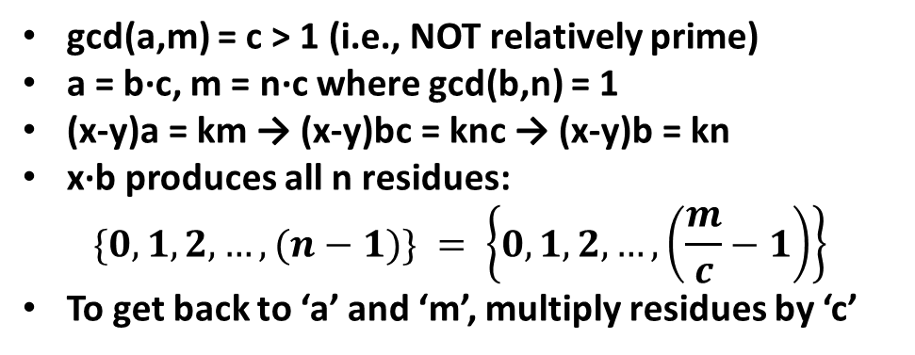
Being relatively prime to the modulus is necessary to have a multiplicative inverse
gcd(a,m) = c > 1 (i.e., NOT relatively prime)
a = b·c, m = n·c where gcd(b,n) = 1
(x-y)a = km → (x-y)bc = knc → (x-y)b = kn
x·b produces all n residues:
$$\{0,1,2,…, (n−1)\} = \left\{0,1,2,…, \left(\frac{m}{c}−1\right)\right\}$$
To get back to ‘a’ and ‘m’, multiply residues by ‘c’
INSERT
VIDEO
HERE

Slide 34
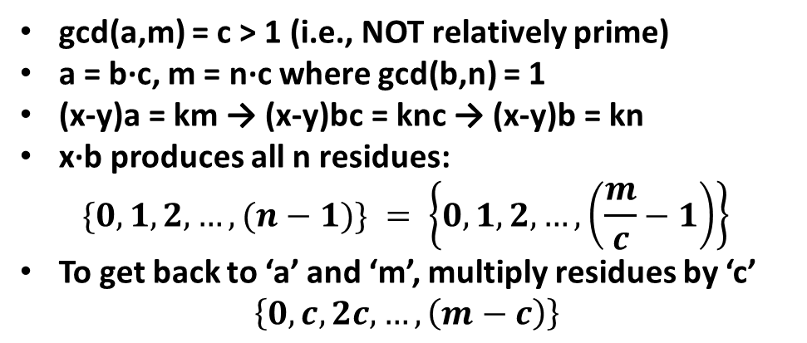
Being relatively prime to the modulus is necessary to have a multiplicative inverse
gcd(a,m) = c > 1 (i.e., NOT relatively prime)
a = b·c, m = n·c where gcd(b,n) = 1
(x-y)a = km → (x-y)bc = knc → (x-y)b = kn
x·b produces all n residues:
$$\{0,1,2,…, (n−1)\} = \left\{0,1,2,…, \left(\frac{m}{c}−1\right)\right\}$$
To get back to ‘a’ and ‘m’, multiply residues by ‘c’
$$\left\{0,c,2c,…, \left(m−c\right)\right\}$$
INSERT
VIDEO
HERE

Slide 35
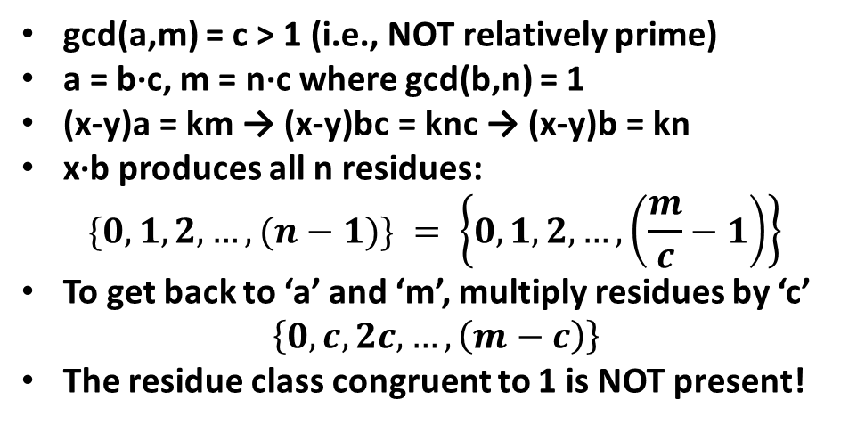
Being relatively prime to the modulus is necessary to have a multiplicative inverse
gcd(a,m) = c > 1 (i.e., NOT relatively prime)
a = b·c, m = n·c where gcd(b,n) = 1
(x-y)a = km → (x-y)bc = knc → (x-y)b = kn
x·b produces all n residues:
$$\{0,1,2,…, (n−1)\} = \left\{0,1,2,…, \left(\frac{m}{c}−1\right)\right\}$$
To get back to ‘a’ and ‘m’, multiply residues by ‘c’
$$\left\{0,c,2c,…, \left(m−c\right)\right\}$$
The residue class congruent to 1 is NOT present!
INSERT
VIDEO
HERE

Slide 36
The Euclidean Algorithm finds gcd(x,y)
INSERT
VIDEO
HERE

Slide 37
The Euclidean Algorithm finds gcd(x,y)
Oldest known algorithm
INSERT
VIDEO
HERE

Slide 38
The Euclidean Algorithm finds gcd(x,y)
Oldest known algorithm
gcd(x,y) = gcd(y, x%y) (x > y)
INSERT
VIDEO
HERE

Slide 39
The Euclidean Algorithm finds gcd(x,y)
Oldest known algorithm
gcd(x,y) = gcd(y, x%y) (x > y)
gcd(2017, 1024)
INSERT
VIDEO
HERE

Slide 40
The Euclidean Algorithm finds gcd(x,y)
Oldest known algorithm
gcd(x,y) = gcd(y, x%y) (x > y)
gcd(2017, 1024)
gcd(1024, 993)
gcd(993, 31)
gcd(31, 1) = 1
INSERT
VIDEO
HERE

Slide 41
The Euclidean Algorithm finds gcd(x,y)
Oldest known algorithm
gcd(x,y) = gcd(y, x%y) (x > y)
gcd(2017, 1024)
gcd(1024, 993)
gcd(993, 31)
gcd(31, 1) = 1
2017 and 1024 are relatively prime
INSERT
VIDEO
HERE

Slide 42
The Euclidean Algorithm efficiently finds gcd(x,y)
INSERT
VIDEO
HERE

Slide 43
The Euclidean Algorithm efficiently finds gcd(x,y)
gcd(x,y) = gcd(y, x%y) = gcd(x%y, (x%y)%y)
INSERT
VIDEO
HERE

Slide 44
The Euclidean Algorithm efficiently finds gcd(x,y)
gcd(x,y) = gcd(y, x%y) = gcd(x%y, (x%y)%y)
If y < (x/2), x%y < (x/2)
INSERT
VIDEO
HERE

Slide 45
The Euclidean Algorithm efficiently finds gcd(x,y)
gcd(x,y) = gcd(y, x%y) = gcd(x%y, (x%y)%y)
If y < (x/2), x%y < (x/2)
If y > (x/2), x%y = x – y < x – (x/2) < (x/2)
INSERT
VIDEO
HERE

Slide 46
The Euclidean Algorithm efficiently finds gcd(x,y)
gcd(x,y) = gcd(y, x%y) = gcd(x%y, (x%y)%y)
If y < (x/2), x%y < (x/2)
If y > (x/2), x%y = x – y < x – (x/2) < (x/2)
Therefore, x % y < (x/2)
INSERT
VIDEO
HERE

Slide 47
The Euclidean Algorithm efficiently finds gcd(x,y)
gcd(x,y) = gcd(y, x%y) = gcd(x%y, (x%y)%y)
If y < (x/2), x%y < (x/2)
If y > (x/2), x%y = x – y < x – (x/2) < (x/2)
Therefore, x % y < (x/2)
Number of iterations is O(log(x))
INSERT
VIDEO
HERE

Slide 48
The Euclidean Algorithm efficiently finds gcd(x,y)
gcd(x,y) = gcd(y, x%y) = gcd(x%y, (x%y)%y)
If y < (x/2), x%y < (x/2)
If y > (x/2), x%y = x – y < x – (x/2) < (x/2)
Therefore, x % y < (x/2)
Number of iterations is O(log(x))
Worst case typically 2·(bits in modulus)
INSERT
VIDEO
HERE

Slide 49
The Euclidean Algorithm actually finds gcd(x,y)
INSERT
VIDEO
HERE

Slide 50
The Euclidean Algorithm actually finds gcd(x,y)
gcd(x,y) = c → c|x and c|y
INSERT
VIDEO
HERE

Slide 51
The Euclidean Algorithm actually finds gcd(x,y)
gcd(x,y) = c → c|x and c|y
x = q·y + r → r = x – q·y = k₁·c – q·k₂·c = k_{c}·c
INSERT
VIDEO
HERE

Slide 52
The Euclidean Algorithm actually finds gcd(x,y)
gcd(x,y) = c → c|x and c|y
x = q·y + r → r = x – q·y = k₁·c – q·k₂·c = k_{c}·c
c|r → gcd(y,r) ≥ gcd(x,y)
INSERT
VIDEO
HERE

Slide 53
The Euclidean Algorithm actually finds gcd(x,y)
gcd(x,y) = c → c|x and c|y
x = q·y + r → r = x – q·y = k₁·c – q·k₂·c = k_{c}·c
c|r → gcd(y,r) ≥ gcd(x,y)
gcd(y,r) = d → d|y and d|r
INSERT
VIDEO
HERE

Slide 54
The Euclidean Algorithm actually finds gcd(x,y)
gcd(x,y) = c → c|x and c|y
x = q·y + r → r = x – q·y = k₁·c – q·k₂·c = k_{c}·c
c|r → gcd(y,r) ≥ gcd(x,y)
gcd(y,r) = d → d|y and d|r
x = q·k₃·d + k₄·d = k_{d}·d
INSERT
VIDEO
HERE

Slide 55
The Euclidean Algorithm actually finds gcd(x,y)
gcd(x,y) = c → c|x and c|y
x = q·y + r → r = x – q·y = k₁·c – q·k₂·c = k_{c}·c
c|r → gcd(y,r) ≥ gcd(x,y)
gcd(y,r) = d → d|y and d|r
x = q·k₃·d + k₄·d = k_{d}·d
d|x → gcd(x,y) ≥ gcd(y,r)
INSERT
VIDEO
HERE

Slide 56
The Euclidean Algorithm actually finds gcd(x,y)
gcd(x,y) = c → c|x and c|y
x = q·y + r → r = x – q·y = k₁·c – q·k₂·c = k_{c}·c
c|r → gcd(y,r) ≥ gcd(x,y)
gcd(y,r) = d → d|y and d|r
x = q·k₃·d + k₄·d = k_{d}·d
d|x → gcd(x,y) ≥ gcd(y,r)
gcd(x,y) = gcd(y,r) = gcd(y,x%y)
INSERT
VIDEO
HERE

Slide 57
In review…
INSERT
VIDEO
HERE

Slide 58
In review…
What a multiplicative inverse in a modular world is
INSERT
VIDEO
HERE

Slide 59
In review…
What a multiplicative inverse in a modular world is
Multiplicative inverses exist when r.p. to modulus
INSERT
VIDEO
HERE

Slide 60
In review…
What a multiplicative inverse in a modular world is
Multiplicative inverses exist when r.p. to modulus
The Euclidean algorithm finds gcd
INSERT
VIDEO
HERE

Slide 61
In review…
What a multiplicative inverse in a modular world is
Multiplicative inverses exist when r.p. to modulus
The Euclidean algorithm finds gcd
Why the Euclidean algorithm works
INSERT
VIDEO
HERE

Slide 62
In review…
What a multiplicative inverse in a modular world is
Multiplicative inverses exist when r.p. to modulus
The Euclidean algorithm finds gcd
Why the Euclidean algorithm works
Coming up
INSERT
VIDEO
HERE

Slide 63
In review…
What a multiplicative inverse in a modular world is
Multiplicative inverses exist when r.p. to modulus
The Euclidean algorithm finds gcd
Why the Euclidean algorithm works
Coming up
Extend the Euclidean algorithm to find multiplicative inverses
INSERT
VIDEO
HERE

Slide 64
SOURCE SLIDES

Slide 65
The analog to division in a modular world is the multiplicative inverse
What a multiplicative inverse is
When a multiplicative inverse exists
The Euclidean algorithm finds the gcd
How efficient the Euclidean algorithm is
Prove the validity of the Euclidean algorithm
Future work – extend the Euclidean algorithm
INSERT
VIDEO
HERE

Slide 66
Division isn't defined, but multiplicative inverses are
Dividing by x = multiplying by reciprocal of x
$$\frac{15}{3}=15∙\frac{1}{3}=15∙3^{−1}$$
Reciprocal also know as multiplicative inverse
Product of x and its multiplicative inverse is 1
INSERT
VIDEO
HERE

Slide 67
mod-7 multiplication table shows every nonzero residue class has an inverse
mod 7 | 0 | 1 | 2 | 3 | 4 | 5 | 6
0 | 0 | 0 | 0 | 0 | 0 | 0 | 0
1 | 0 | 1 | 2 | 3 | 4 | 5 | 6
2 | 0 | 2 | 4 | 6 | 1 | 3 | 5
3 | 0 | 3 | 6 | 2 | 5 | 1 | 4
4 | 0 | 4 | 1 | 5 | 2 | 6 | 3
5 | 0 | 5 | 3 | 1 | 6 | 4 | 2
6 | 0 | 6 | 5 | 4 | 3 | 2 | 1
INSERT
VIDEO
HERE

Slide 68
mod-7 multiplication table shows every nonzero residue class has an inverse
mod 7 | 0 | 1 | 2 | 3 | 4 | 5 | 6
0 | 0 | 0 | 0 | 0 | 0 | 0 | 0
1 | 0 | 1 | 2 | 3 | 4 | 5 | 6
2 | 0 | 2 | 4 | 6 | 1 | 3 | 5
3 | 0 | 3 | 6 | 2 | 5 | 1 | 4
4 | 0 | 4 | 1 | 5 | 2 | 6 | 3
5 | 0 | 5 | 3 | 1 | 6 | 4 | 2
6 | 0 | 6 | 5 | 4 | 3 | 2 | 1
mod 7 | 0 | 1 | 2 | 3 | 4 | 5 | 6
0 | 0 | 0 | 0 | 0 | 0 | 0 | 0
1 | 0 | 1 | 2 | 3 | 4 | 5 | 6
2 | 0 | 2 | 4 | 6 | 1 | 3 | 5
3 | 0 | 3 | 6 | 2 | 5 | 1 | 4
4 | 0 | 4 | 1 | 5 | 2 | 6 | 3
5 | 0 | 5 | 3 | 1 | 6 | 4 | 2
6 | 0 | 6 | 5 | 4 | 3 | 2 | 1
INSERT
VIDEO
HERE

Slide 69
mod-15 multiplication table shows many nonzero residue classes don’t
Mod 15 | 0 | 1 | 2 | 3 | 4 | 5 | 6 | 7 | 8 | 9 | 10 | 11 | 12 | 13 | 14
0 | 0 | 0 | 0 | 0 | 0 | 0 | 0 | 0 | 0 | 0 | 0 | 0 | 0 | 0 | 0
1 | 0 | 1 | 2 | 3 | 4 | 5 | 6 | 7 | 8 | 9 | 10 | 11 | 12 | 13 | 14
2 | 0 | 2 | 4 | 6 | 8 | 10 | 12 | 14 | 1 | 3 | 5 | 7 | 9 | 11 | 13
3 | 0 | 3 | 6 | 9 | 12 | 0 | 3 | 6 | 9 | 12 | 0 | 3 | 6 | 9 | 12
4 | 0 | 4 | 8 | 12 | 1 | 5 | 9 | 13 | 2 | 6 | 10 | 14 | 3 | 7 | 11
5 | 0 | 5 | 10 | 0 | 5 | 10 | 0 | 5 | 10 | 0 | 5 | 10 | 0 | 5 | 10
6 | 0 | 6 | 12 | 3 | 9 | 0 | 6 | 12 | 3 | 9 | 0 | 6 | 12 | 3 | 9
7 | 0 | 7 | 14 | 6 | 13 | 5 | 12 | 4 | 11 | 3 | 10 | 2 | 9 | 1 | 8
8 | 0 | 8 | 1 | 9 | 2 | 10 | 3 | 11 | 4 | 12 | 5 | 13 | 6 | 14 | 7
9 | 0 | 9 | 3 | 12 | 6 | 0 | 9 | 3 | 12 | 6 | 0 | 9 | 3 | 12 | 6
10 | 0 | 10 | 5 | 0 | 10 | 5 | 0 | 10 | 5 | 0 | 10 | 5 | 0 | 10 | 5
11 | 0 | 11 | 7 | 3 | 14 | 10 | 6 | 2 | 13 | 9 | 5 | 1 | 12 | 8 | 4
12 | 0 | 12 | 9 | 6 | 3 | 0 | 12 | 9 | 6 | 3 | 0 | 12 | 9 | 6 | 3
13 | 0 | 13 | 11 | 9 | 7 | 5 | 3 | 1 | 14 | 12 | 10 | 8 | 6 | 4 | 2
14 | 0 | 14 | 13 | 12 | 11 | 10 | 9 | 8 | 7 | 6 | 5 | 4 | 3 | 2 | 1
INSERT
VIDEO
HERE

Slide 70
Being relatively prime to the modulus is sufficient to have a multiplicative inverse
gcd(a,m) = 1 (i.e., relatively prime)
Sequence of m values: {0·a, 1·a, 2·a, …, (m-1)·a}
Pick x and y that are NOT congruent (mod m)
Can x·a ≡ y·a (mod m) ?
Requires (x-y)·a = km
Since ‘a’ has no factors of ‘m’, (x-y) | m
But –m < (x-y) < m and (x-y) ≠ 0
No two members of sequence are congruent
Pigeonhole Principle: 1 member is congruent to 1
INSERT
VIDEO
HERE

Slide 71
Being relatively prime to the modulus is necessary to have a multiplicative inverse
gcd(a,m) = c > 1 (i.e., NOT relatively prime)
a = b·c, m = n·c where gcd(b,n) = 1
(x-y)a = km → (x-y)bc = knc → (x-y)b = kn
x·b produces all n residues:
$$\{0,1,2,…, (n−1)\} = \left\{0,1,2,…, \left(\frac{m}{c}−1\right)\right\}$$
To get back to ‘a’ and ‘m’, multiply residues by ‘c’
$$\left\{0,c,2c,…, \left(m−c\right)\right\}$$
The residue class congruent to 1 is NOT present!
INSERT
VIDEO
HERE

Slide 72
The Euclidean Algorithm finds gcd(x,y)
Oldest known algorithm
gcd(x,y) = gcd(y, x%y) (x > y)
gcd(2017, 1024)
gcd(1024, 993)
gcd(993, 31)
gcd(31, 1) = 1
2017 and 1024 are relatively prime
INSERT
VIDEO
HERE

Slide 73
The Euclidean Algorithm efficiently finds gcd(x,y)
gcd(x,y) = gcd(y, x%y) = gcd(x%y, (x%y)%y)
If y < (x/2), x%y < (x/2)
If y > (x/2), x%y = x – y < x – (x/2) < (x/2)
Therefore, x % y < (x/2)
Number of iterations is O(log(x))
Worst case typically 2·(bits in modulus)
INSERT
VIDEO
HERE

Slide 74
The Euclidean Algorithm actually finds gcd(x,y)
gcd(x,y) = c → c|x and c|y
x = q·y + r → r = x – q·y = k₁·c – q·k₂·c = k_{c}·c
c|r → gcd(y,r) ≥ gcd(x,y)
gcd(y,r) = d → d|y and d|r
x = q·k₃·d + k₄·d = k_{d}·d
d|x → gcd(x,y) ≥ gcd(y,r)
gcd(x,y) = gcd(y,r) = gcd(y,x%y)
INSERT
VIDEO
HERE

Slide 75
In review…
What a multiplicative inverse in a modular world is
Multiplicative inverses exist when r.p. to modulus
The Euclidean algorithm finds gcd
Why the Euclidean algorithm works
Coming up
Extend the Euclidean algorithm to find multiplicative inverses
INSERT
VIDEO
HERE

